Slide 1
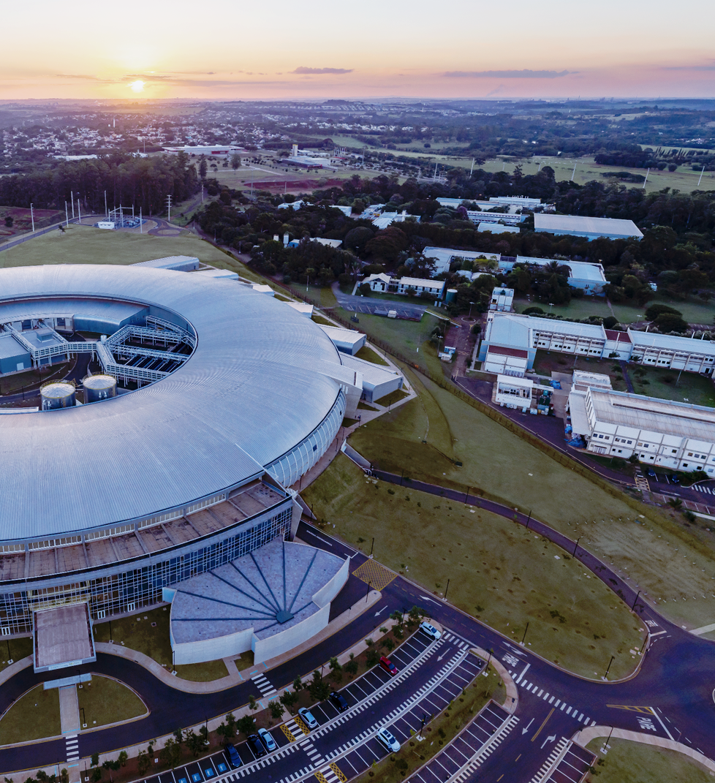

MXCuBE at the Brazilian Synchrotron Light
Laboratory – LNLS/Sirius
Status Report
Nicolas Guilhermo Silva Moliterno
Computing Platforms (COMP)
MXCuBE Meeting – DESY and EMBL, 20 May 2024

Slide 2
MXCuBE status
Versions: Backend | Database & Frontend
Production Version: Web MXCuBE3 - Backend and Frontend
Development Version: Web MXCuBE3, Web MXCuBE4, mxcubecore

Slide 3
Developments since last meeting
Improving: LNLSCollect Class
Creation and updating of the snapshot system before collections begin.
Improvements in logs, error handling, and attempts to prevent scans from crashing.
Debugging the acquisition loop.

Slide 4
BlueSky with MXCuBE in LNLS:
Update of the LNLSCollect class for using bluesky plans.
Integration of the Http-server API for running plans.
Integration with a Kafka instance for the live monitoring of the plans.

Slide 5
Updated and cleaned up:
LNLSDetDistMotor Class
Update moves with granite.
LNLSCollect Class
Snapshot procced before scan.
LNLSMachInfo Class
Update of XML files to reflect new machine configurations.
Tests, CI/CD and Code Quality:
Integration with SonarQube and more jobs.

Slide 6
Parallel Developments
An automatic pipeline for multiple crystals experiments has been implemented. It uses XDS, CCP4 and Phenix.
An automatic pipeline for synchrotron serial crystallography (SSX) is under development. It uses CrystFEL.
A web application for data processing has been developed and deployed.

Slide 7
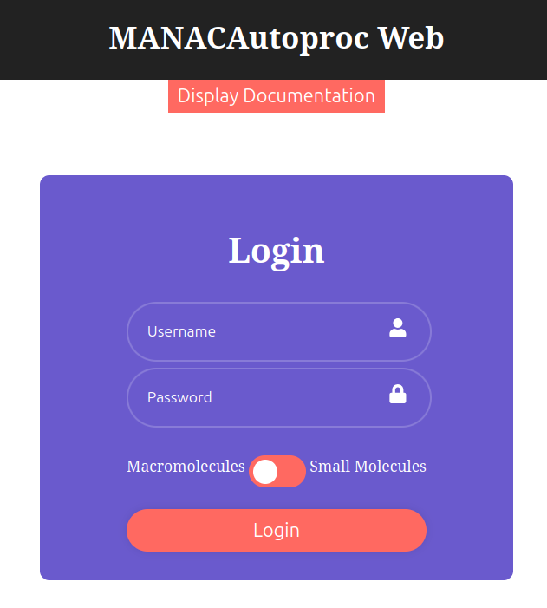
Parallel Developments – Data Processing
MANACAutoproc Web: web application where users can access and process their data.
This app also allows the users to visualize their diffraction data using H5web components, as well as model their processed data with Moorhen.

Slide 8
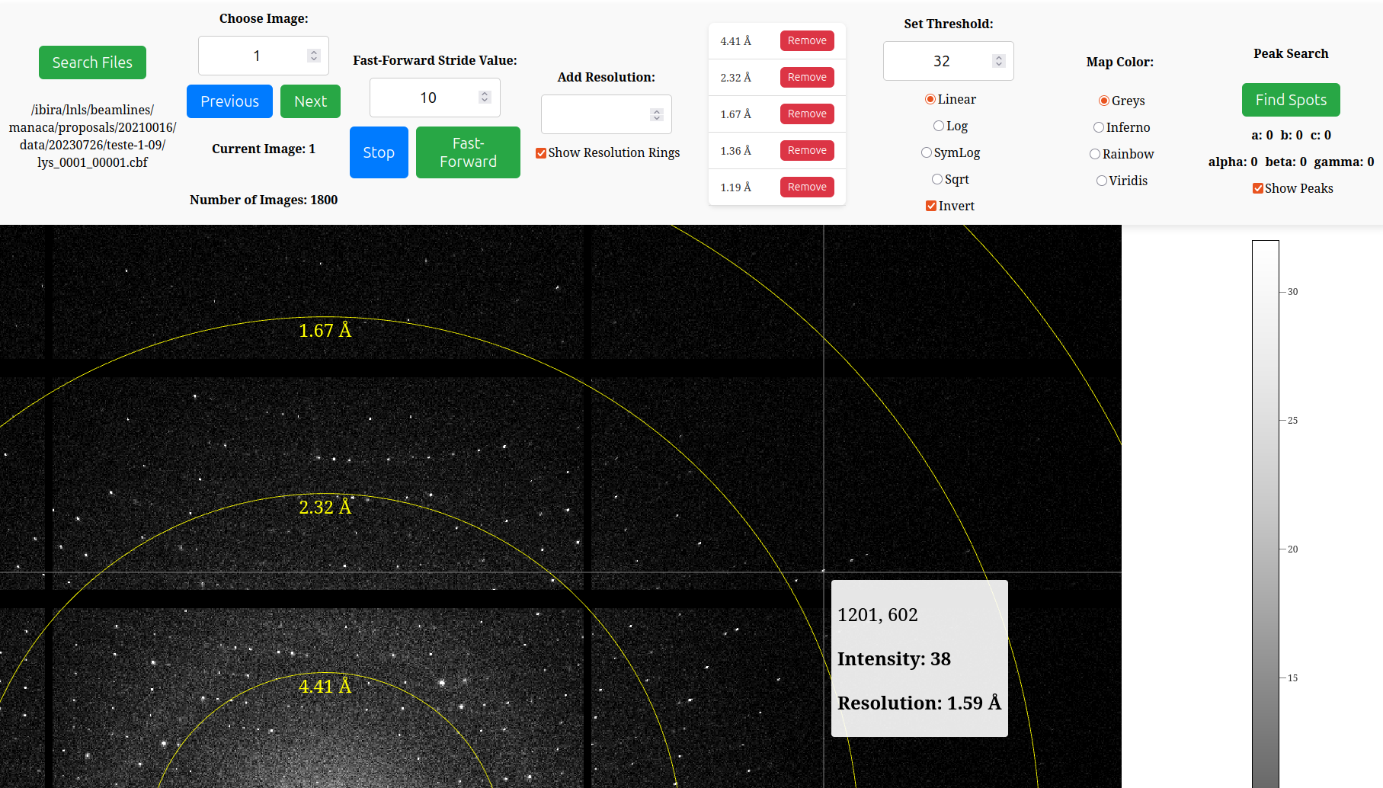
Parallel Developments – Image Viewer

Slide 9
Parallel Developments – Image Viewer
Used for visualizing data collected at the beamline.
Uses H5Web.
Insipired by Braggy from ESRF.

Slide 10
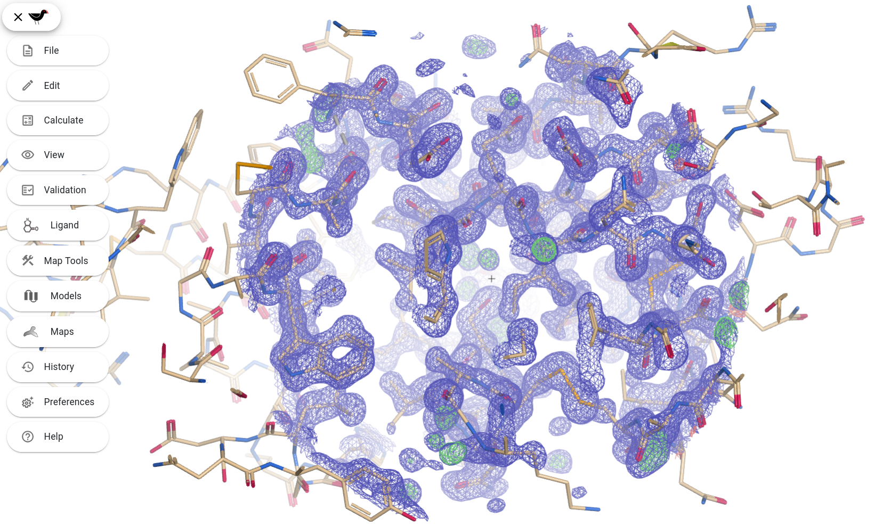
Parallel Developments – Moorhen

Slide 11
Parallel Developments – Moorhen
Moorhen is a web version of coot, created by a team of developers in the UK.
A local instance of Moorhen has been implemented and connected to our database.
Users can easily access and model the data that has been processed at the beamline.

Slide 12
Plans for the next six months
Update of LNLSCollect and complete integration with Bluesky.
Integrate new equipments and scans, refactor LNLS files.
Test MXCuBE 4/5 with new scan routines.

Slide 13



Thank you
Nicolas Guilhermo Silva Moliterno
nicolas.moliterno@lnls.br
Sign up to receive newsletters about CNPEM and its units
cnpem.br

